Slide 1
Big Data Platforms
Lecture 4 – Hadoop
Lecturer: Shay Sakazi
Teaching Assistants: Yarden Fogel & Roei Arpaly

Slide 2
Previous lecture
Distributed system
CAP
Strong and Weak consistency
NoSQL databases types
How to choose databases
RDBMS vs. NoSQL

Slide 3
Agenda
Distributed, large scale, file systems
The Google File System
The Hadoop File System
Distributed large scale processing
The MapReduce framework

Slide 4
File System (FS) (Reminder)

Slide 5
What is FS?
In computing, file system or filesystem (often abbreviated to fs) is a method and data structure that the operating system uses to control how data is stored and retrieved.
Without a file system, data placed in a storage medium would be one large body of data with no way to tell where one piece of data stopped and the next began, or where any piece of data was located when it was time to retrieve it.
By separating the data into pieces and giving each piece a name, the data are easily isolated and identified.
Taking its name from the way a paper-based data management system is named, each group of data is called a "file".
The structure and logic rules used to manage the groups of data and their names is called a "file system."
Wikipedia

Slide 6
Google File System (GFS)

Slide 7
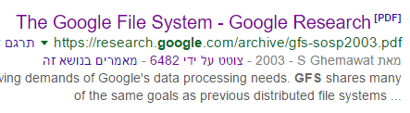
The Google File System (published@2003)
Google File System pdf link

Slide 8
What is GFS?
A file system created by Google to provide efficient, reliable access to data using large clusters of commodity hardware.
Google uses large files that are difficult to manage with a standard file system (a distributed file)
First fully released as Colossus in 2010.

Slide 9
Commodity hardware
Commodity hardware, in an IT context, is a device or device component that is relatively inexpensive, widely available and interchangeable with other hardware of its type.
So why Google want to use this hardware?
Commodity hardware uses large number of parallel computing components that are low cost, low performance and work together to get the best computation at the lowest cost.

Slide 10
Goals of GFS
Performance - Optimize actions like read, write or create files.
Scalability – easy way of adding capacity to the system
Reliability – be able to work with failures (achive with redundancy)

Slide 11
Design of GFS
Similar API to other file system
Create/delete
Open/close
Read/write
Special operations
Snapshot – create a copy of a file or a directory tree at low cost (create three replicas of the file in different servers)
Append – allows clients to add information to an existing file without overwriting previously written data

Slide 12
GFS Architecture (Analogy)
On a single-machine FS:
An upper layer maintains the metadata, and the user access to a file
A lower layer (i.e., disk) stores the data in units called “blocks”
In the GFS:
A master process maintains the metadata, and the user's access.
A lower layer (i.e., a set of chunk servers) stores the data in units called “chunks”

Slide 13
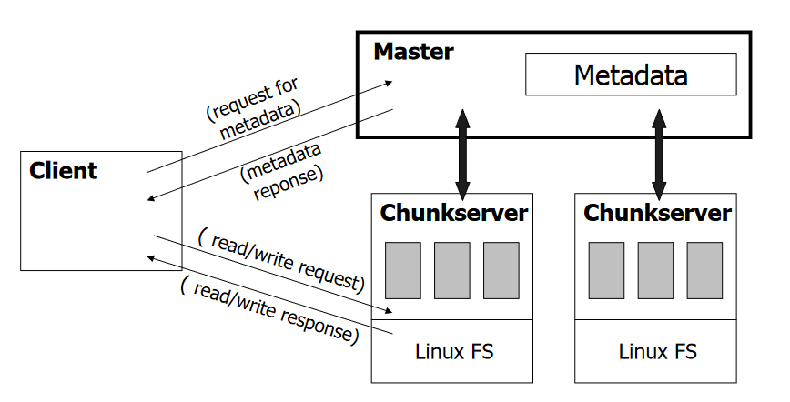
GFS Architecture – overview

Slide 14
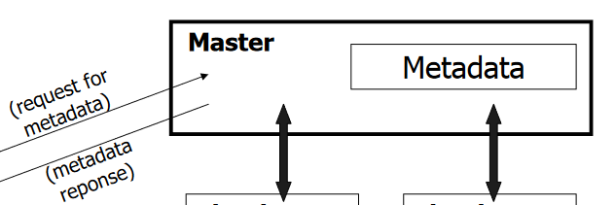
GFS Architecture - Master
A single process running on a separate machine
Stores all metadata
File namespace
File to chunk mapping
Chunk location information
Access control information
Chunk version numbers
Etc.

Slide 15
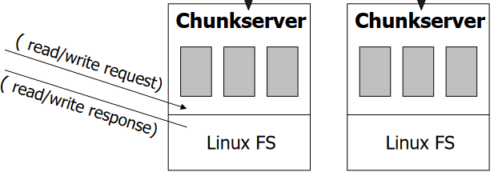
GFS Architecture – Chunk server
The chunk server's stores data as Linux files on local disks
The stored data is divided into chunks (64MB), which are replicated in the network a minimum of three times.
The large chunk size reduces network overhead
Files are stored in hierarchical directories identified by path names

Slide 16
GFS Architecture - Chunk
Analogous to block, except larger
Size: 64MB
Stored on chunk server as file
Chunk handle used to reference a chunk
Chunk replicated across multiple chunk servers
Note: There are hundreds of chunk servers in a GFS cluster distributed over multiple racks.

Slide 17
GFS Architecture – Master <-> Chunk server communication
Master and chunk servers communicate regularly to obtain state:
Is chunk server down?
Are there disk failures on chunk server?
Are any replicas corrupted?
Which chunk replicas does chunk server store?
Master sends instructions to chunk server:
Delete existing chunk
Create new chunk

Slide 18
GFS Architecture – Serving requests
Client retrieves metadata for operation from master
Read/Write data flows between client and chunk server

Slide 19
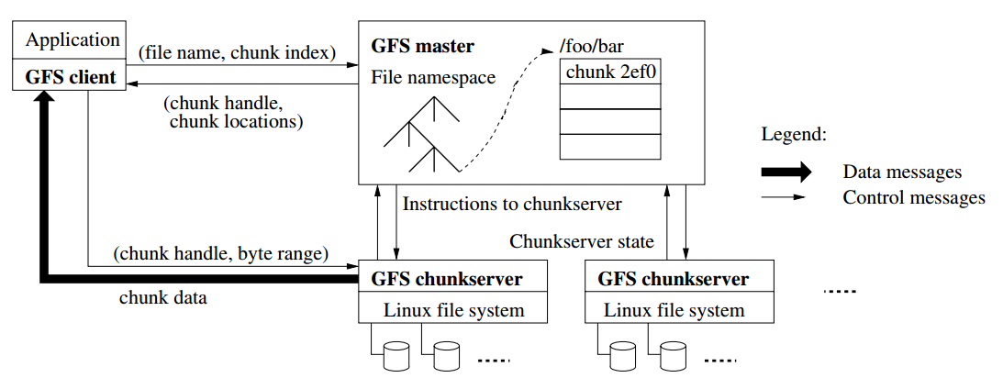
GFS Architecture
Single master that access by the clients
The files are divided to 64MB chunks with a unique chunk id
The files are like those in original OS, but they are distributed over the system

Slide 20
Chunks are Large
Data is stored in 64Mb files
Each such file is called a chunk
Why big chunks?
Fewer requests for meta-data
Fewer meta-data elements (can store in-memory)
Encourages clients to perform multiple operations on the same chunk (less network)
Disadvantages of big chunks?

Slide 21
Meta data
The master stores meta data about files
File namespace (directory structure)
Mapping of files to chunks
The location of each chunk (which chunkservers)
Meta data is stored in the master’s memory
Items 1&2 are also stored on disk
How will we know chunk locations after the master crushes?
We can ask the chunkserver, as they store it.
Notes:
This avoids the need to sync the disks of chunkservers and master with chunk location
(only need to sync master’s memory with chunkservers files system)
“no point in trying to maintain a consistent view of this information on the master”

Slide 22
Operations Log
Contains all critical changes made to the meta data
Files and chunks (but not chunk location)
Versions
If we lose this, we cannot find our data
This is stored on disk and replicated
This data must be consistent
This data must be reliable to failures

Slide 23
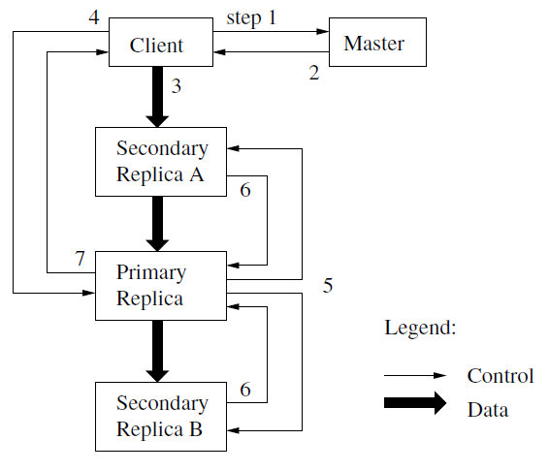
Writing to a Chunk

Slide 24
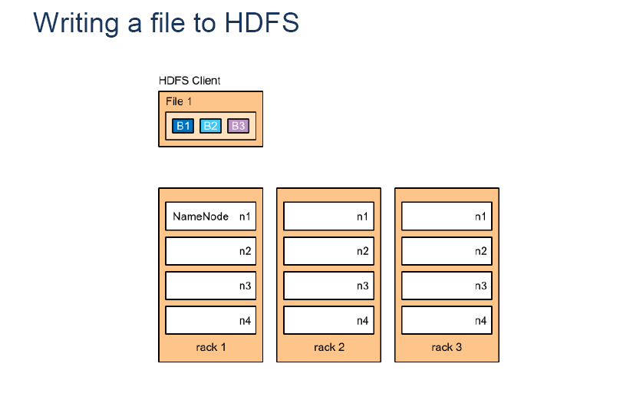
Writing a File

Slide 25
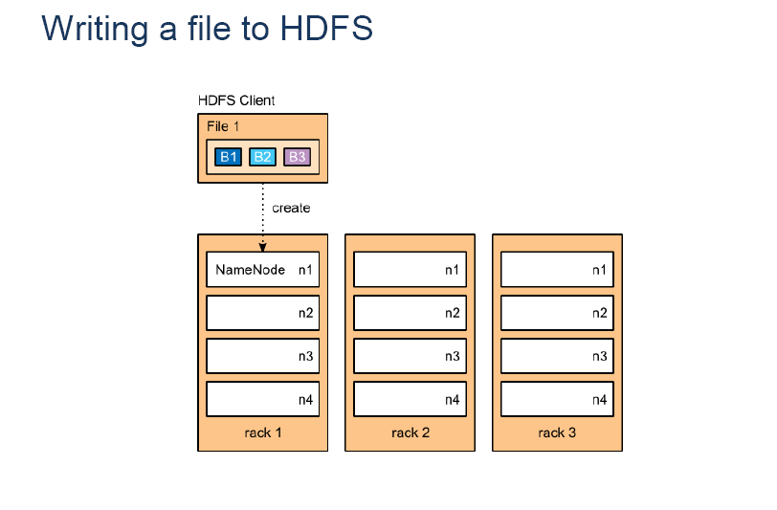
Writing a File

Slide 26
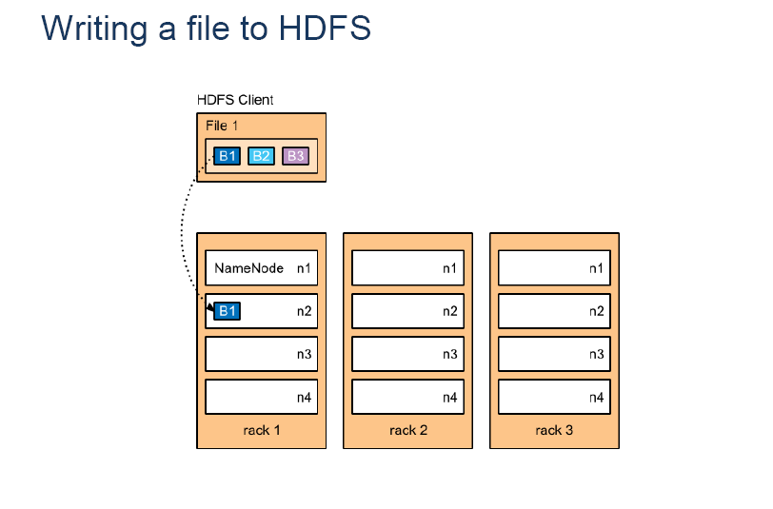
Writing a File

Slide 27
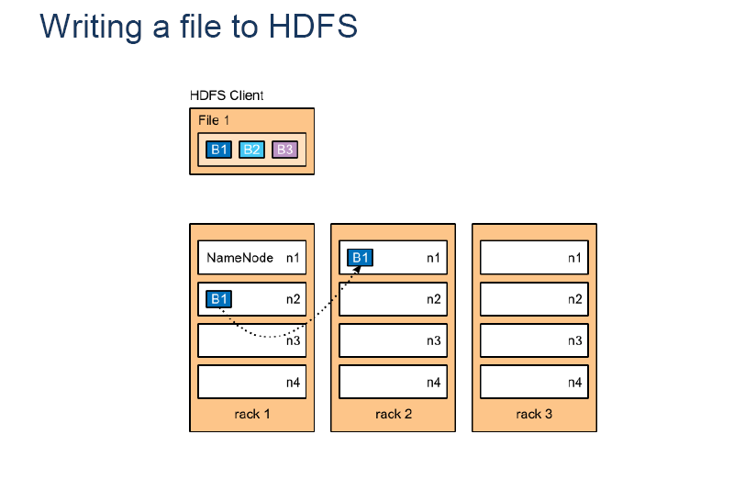
Writing a File

Slide 28
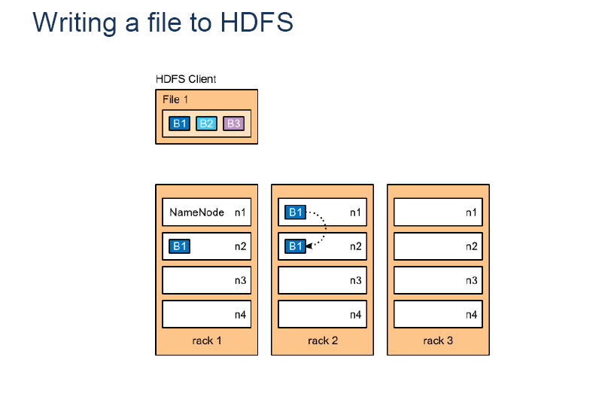
Writing a File

Slide 29

Writing a File

Slide 30

Writing a File

Slide 31
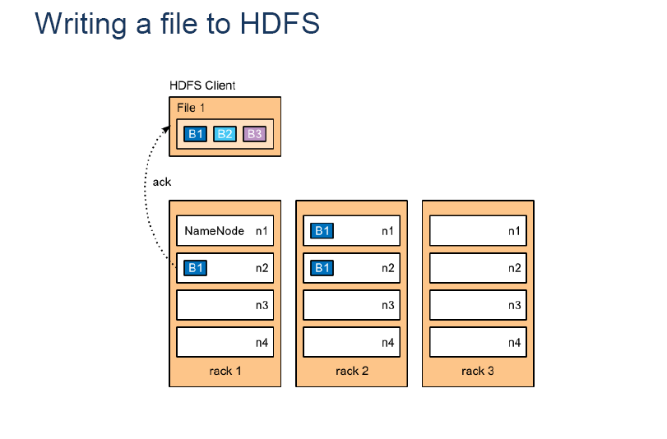
Writing a File

Slide 32
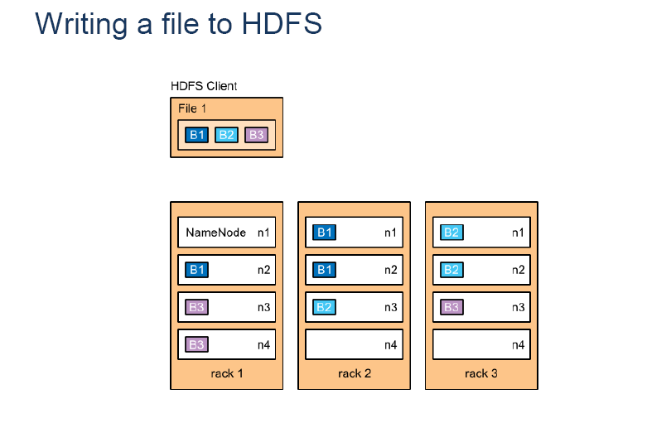
Writing a File

Slide 33
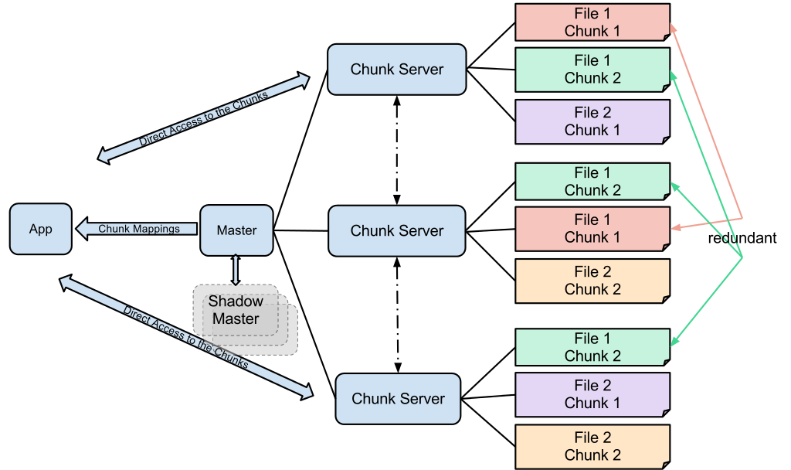
GFS design

Slide 34
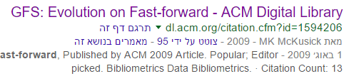
GFS Today?
Size of data grew beyond expectations
A single master node is not enough
Number of files grew to be too large
Low latency is needed in some applications
Think about video streaming
Google File System #2: Colossus

Slide 35

Hadoop File System (HDFS)

Slide 36

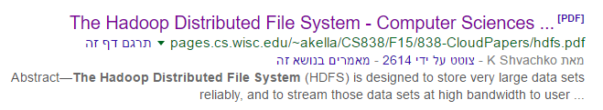
The Hadoop Distributed File System (publish@2010)
“Hadoop clusters at Yahoo! span 25,000 servers, and store 25 petabytes of application data, with the largest cluster being 3500 servers.”

Slide 37
What is Hadoop?
An open-source project overseen by Apache
Committers from different organizations
Including Intel, Facebook, and Yahoo
Several Hadoop distributers
Apache (open source and free)
Cloudera et al.
Cloud – Amazon AWS, Microsoft Azure

Slide 38
What is Hadoop?
Core components
HDFS
MapReduce
Many other projects around the core Hadoop
Often referred to as the Hadoop Ecosystem
Pig, Hive, Hbase, …
Hadoop cluster
A set of machines running HDFS and MapReduce

Slide 39
Nodes and more
Nodes are Organized into racks.
Racks are Organized into a cluster
A Cluster can be dispersed to several Data-Centers

Slide 40
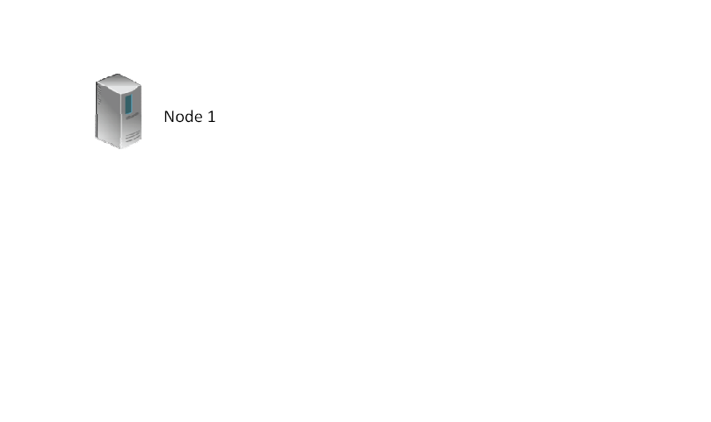
A node

Slide 41
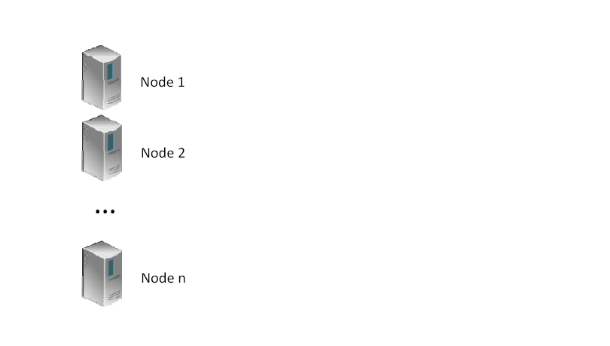
Set of Nodes

Slide 42
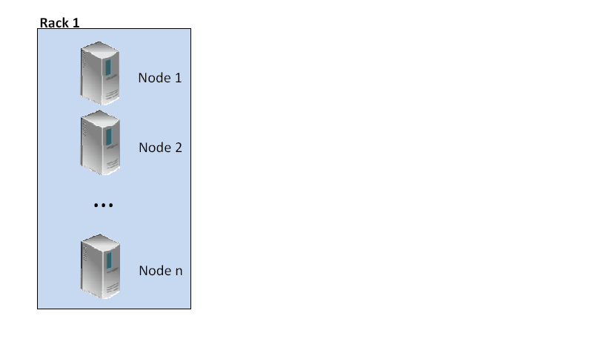
Rack

Slide 43
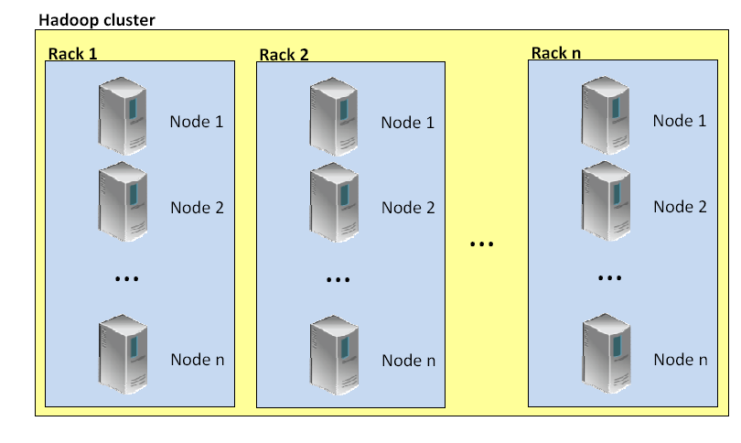
Cluster

Slide 44
Hadoop Architecture

Slide 45
NameNode – The Master
The centerpiece component of the system. It maintains and manages metadata for the files, such as what are the blocks of each file, and where they are stored
Usually, it is a strong server with high RAM availability
Handles DataNode failures

Slide 46
DataNode
Stores the file data
Can run on various underlining file systems (NTFS/ext4/…)
Responds to requests from the NameNode
DataNode instances talk to each other when they are replicating data

Slide 47
HDFS – Shell (Samples)
List files:
$ hdfs dfs -ls /
$ hdfs dfs -l -R /var
Disk usage:
$ hdfs dfs -df -h /
Create Directory:
$ hdfs dfs -mkdir mydata
Copy files to/from HDFS:
$ hdfs dfs -copyFromLocal
$ hdfs dfs -copyToLocal
File access list:
$ hdfs dfs -getfacl
File Stats:
$ hdfs dfs -stat
Cluster Report (Admin):
hdfs dfsadmin –report

Slide 48
HDFS vs. GFS
HDFS | GFS
NameNode | Master node
DataNode | Chunk server
Block (128Mb)* | Chunk (64Mb)*
Namespace image | Meta data
Journal | Operations log

Slide 49
HDFS – Replication Management
A block may be under- or over-replicated
HDFS manages and tries to balance this
A background job
Key considerations
Do not write multiple replicas on the same node
Do not write more than two replicas on the same rack

Slide 50
Typical node in Hadoop (@2010)
2 quad core Xeon processors @ 2.5ghz
Red Hat Enterprise Linux Server Release 5.1
Sun Java JDK 1.6.0_13-b03
4 directly attached SATA drives (one terabyte each)
16G RAM
1-gigabit Ethernet

Slide 51
Ok, data is stored in a distributed file system
…now what?

Slide 52
Working with Large and Distributed Data
With a file system you can
Write and modify files
Read files
Organize in directories
With a relational database you can
Insert, update, and delete records
Run basic queries (select X from Y where Z)
Perform complex analytics of the data
How to do this on in HDFS?

Slide 53
Map-Reduce

Slide 54
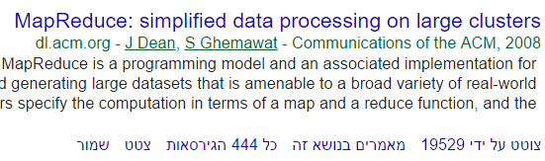
Large Scale Analytics in HDFS?
Map-Reduce!
“Users specify a map function that processes a key/value pair to generate a set of intermediate key/value pairs, and a reduce function that merges all intermediate values associated with the same intermediate key”

Slide 55
Map Reduce
Raw Input
…
Input: <key, value>
Input: <key, value>
…
MAP
MAP
<K1, V1>
<K2,V2>
<K3,V3>
…
REDUCE
REDUCE

Slide 56
Word count
(the most well-known example of Map/reduce)
Input: a block that contains
Many files that contain text
Output: # times each word is mentioned
File1.txt, “to be or not to be”
File2.txt, “to sleep or not to sleep”
{“to”, 4}, {“be”, 2},{“or”, 2},{“not”,2}, {“sleep”,2}

Slide 57
Word Count - Mapper
map(key, value):
// key: document name; value: text of document
for each word w in value:
emit(w, 1)
This is counter intuitive why to duplicate records?
File1.txt, “to be or not to be”
{“to”, 1}, {“be”, 1},{“or”, 1},{“not”,1}, {“to”, 1}, {“be”, 1}

Slide 58
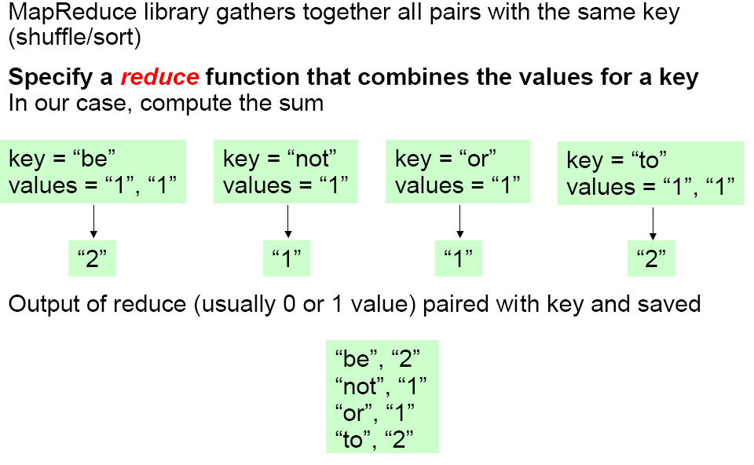
Word Count - Reducer
reduce(key, values):
// key: a word; value: an iterator over counts
result = 0
for each count v in values:
result += v
emit(key,result)

Slide 59
Word count - illustrated
The Word count task is to count how many times each word appears given an input text.
MapReduce is of course not needed for such task, and a simple Python script on your computer would be fine.
But what if your input text is a whole book? Thousands of books? Millions of books? …
Example link

Slide 60
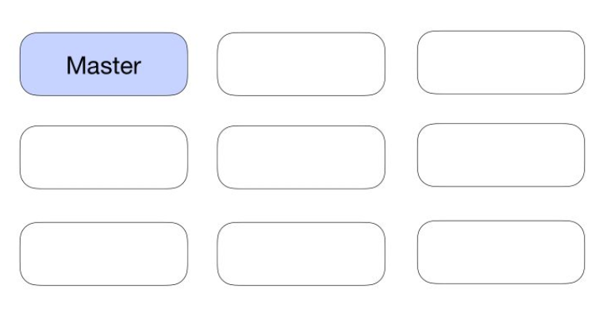
Step 1: Elect the Master
Let’s assume we have Nine nodes in our system.
Our first step is to select a Master Node, and the rest will be worker nodes.

Slide 61
Master node tasks - reminder
The role of the Master Node is:
split the input data on different machines
remember which machine handles which part of the data
handle duplicates to avoid loss of information if a worker fails
aggregate the outputs and sort the final list

Slide 62
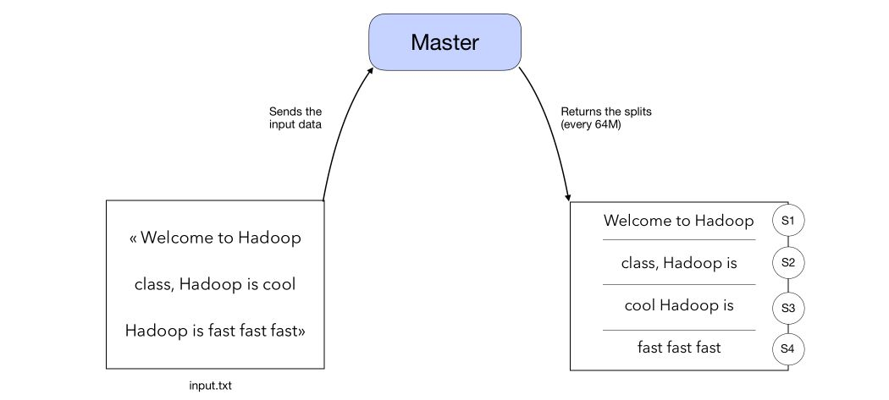
Step 2: Split the input data
The input data is split into blocks of 64Mb.
A 1Ko text file might use a whole 64Mb data node inside a cluster, so it is preferable to have rather big files.
Optimization tools are provided by Hadoop.

Slide 63
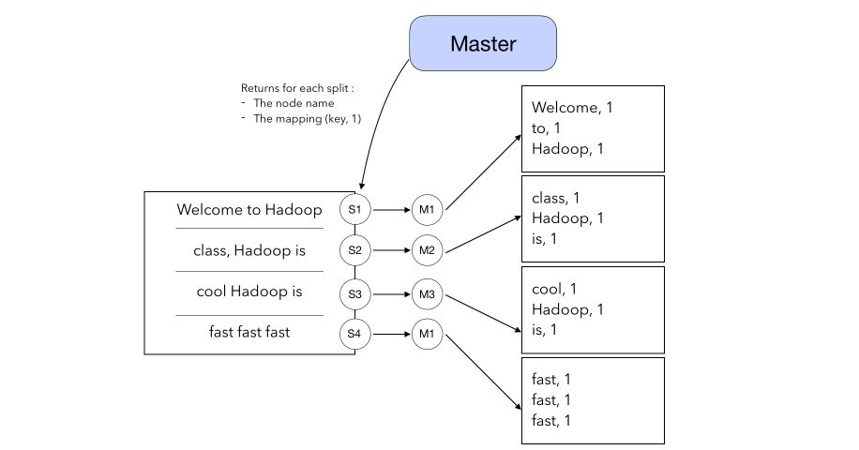
Step 3: Map

Slide 64
Step 3: Map
In the Map step, the Master returns for each split :
the node name to which the split should be sent
the mapping (Key, value) where value is equal to 1 for every word of the split

Slide 65
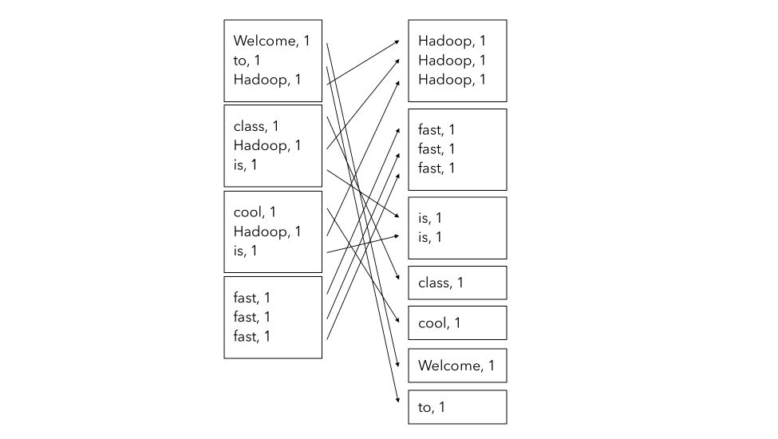
Step 4: Shuffle

Slide 66
Step 4: Shuffle
In the Shuffle step, the Map-Reduce algorithm groups the words by similarity (group a dictionary by key).
It is called Shuffle because the initial splits are no longer used

Slide 67
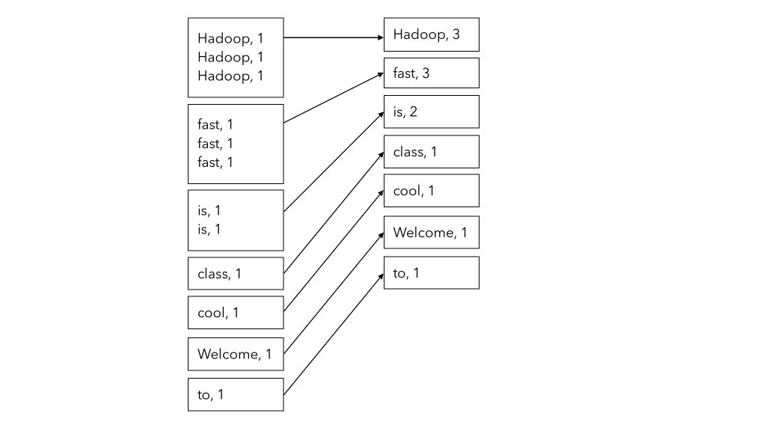
Step 5: Reduce

Slide 68
Step 5: Reduce
In the Reduce step, we simply compute the sum of all values for a given key.
This is simply the sum of all the 1’s of the key.
Remember that this step is still parallelized, so the Master still handles how the different key-value attributes are stored and computed across the different machines.

Slide 69
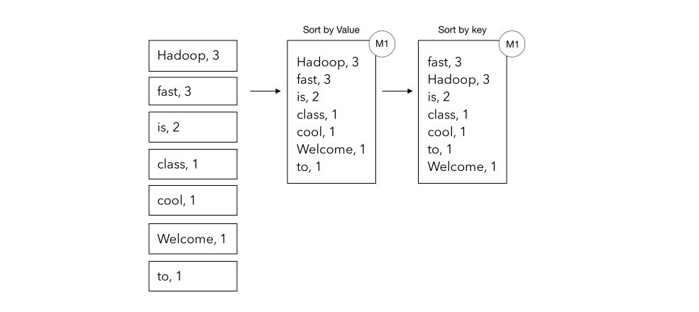
Step 6: Sorting (not mandatory)
The last step is to sort by (first) value, then by key, and return the final list as a .txt file.

Slide 70
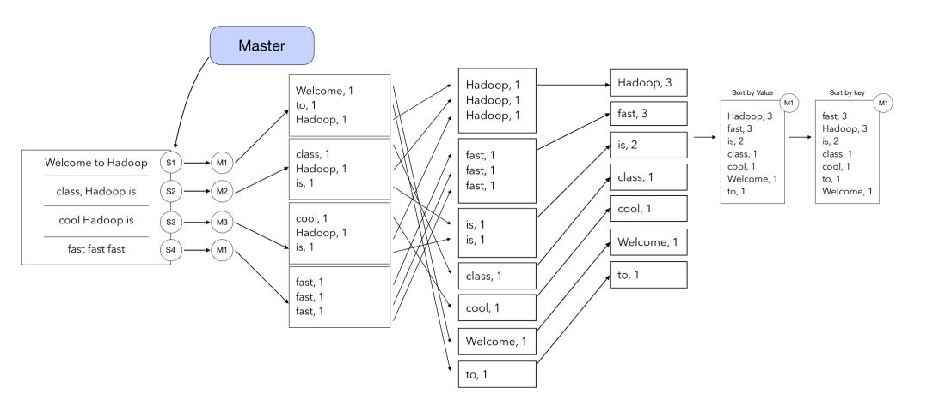
Putting all steps together

Slide 71
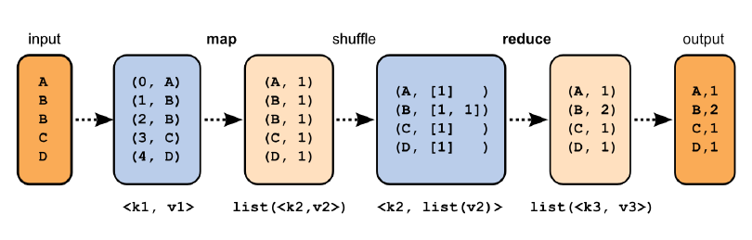
Word Count - Illustration
preprocessing

Slide 72
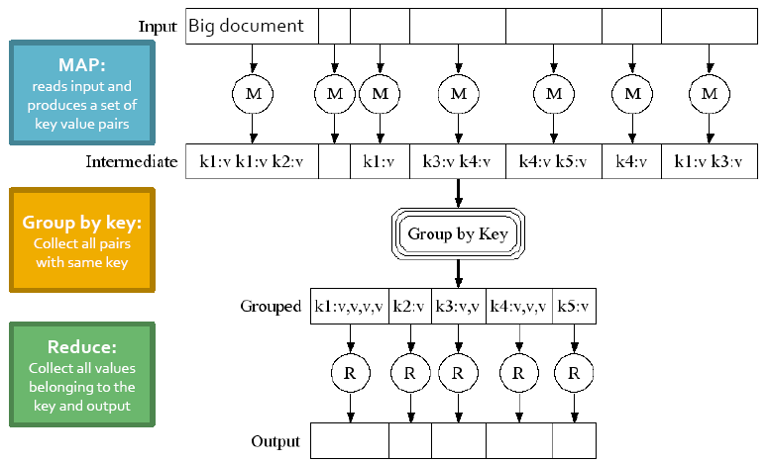
Word Count – Illustration #2

Slide 73
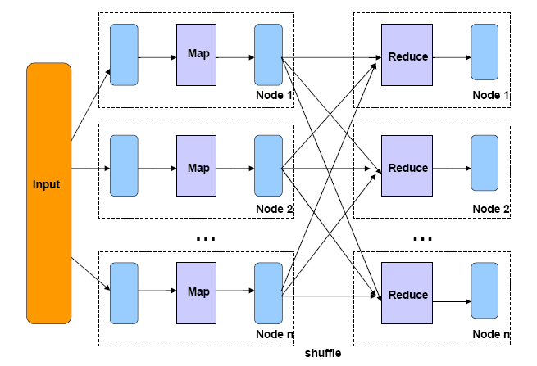
Word Count – Illustration #3

Slide 74
Word Count – Illustration #4

Slide 75
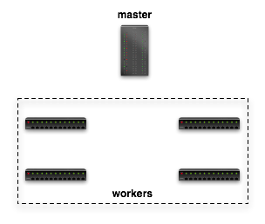

Dataflow in Hadoop
Submit job
map
schedule
reduce
map
reduce

Slide 76
Dataflow in Hadoop
Read
Input File
map
reduce
Block 1
HDFS
Block 2
map
reduce
Notes:
The map phase reads the task’s split/HDFS blocks from HDFS,parses it into records (key/value pairs), and applies the map function to each record.
After the map function has been applied to each input record, the commit phase registers the final output with the TaskTracker, which then informs the JobTracker that the task has finished executing.

Slide 77
Dataflow in Hadoop
map
Local FS
reduce
HTTP GET
map
Local FS
reduce
Notes:
a reduce task fetches data from ach map task by issuing HTTP requests to a configurable number of TaskTrackers at once (5 by default). The Job-
Tracker relays the location of every TaskTracker that hosts map output to every TaskTracker that is executing a reduce task. Note that a reduce task cannot fetch the output of a map task until the map has finished executing and committed its final output to disk

Slide 78
Dataflow in Hadoop
Write Final Answer
reduce
HDFS
reduce
Notes:
In this design, the output of both map and reduce tasks is written to disk before it can be consumed. This is particularly expensive for reduce tasks, because their output is written to HDFS. Output materialization simplifies fault tolerance, because it reduces the amount of state that must be restored to consistency after a node failure. If any task (either map or reduce) fails, the JobTracker simply schedules a new task to perform the same work as the failed task.

Slide 79
Map Reduce vs. Parallel RDBMS
[Pavlo et al., SIGMOD 2009, Stonebraker et al., CACM 2010, …]
 | Parallel DBMS | MapReduce
Schema Support | ✓ | Not out of the box
Indexing | ✓ | Not out of the box
Programming Model | Declarative (SQL) | Imperative (C/C++, Java, …) Extensions through Pig and Hive
Optimizations (Compression, Query Optimization) | ✓ | Not out of the box
Flexibility | Not out of the box | ✓
Fault Tolerance | Coarse grained techniques | ✓
Number of Nodes | A few Large Nodes | 10k of commodity servers

Slide 80
Map Reduce vs. Parallel RDBMS (cont.)
Focus is fundamentally different
MR style systems excel at
Complex analytics
Extract, Transform, Load (ETL) tasks
Parallel DBMSs excel at querying of large data sets
The two technologies are complementary
Notes:
Reducer-side: map tuples according to the join columns. So each reducer gets the matching tuples,
and only needs to do the cross product
Mapper-side: each mapper reads a tuple and searches for matching tuples in the other table
In-memory join: load one table to all mappers, and have each mapper get chunks of the other table.
Stripped variant: load parts of one table to all mappers, compute the joints to that part
and then repeat with the other parts (think of symmetric replicate and partition)
Memcached – use a distributed memory instead of a regular memory

